Slide 1
EasyWatch
( Movie Streaming Platform )

Slide 2
-: Team Members :-
IT014 - Preet Chauhan - 19ITUBS145
IT128 - Vivek Rajpara - 19ITUES049
-: Guided By :-
Internal Guide : External Guide :
Prof. N.P.Desai Ravindra Singh
Faculty of Department of IT Training Specialist
Faculty Of Technology DDU RapidOps Inc.,Ahmedabad
COMPANY DETAILS : RapidOps Inc., AHMEDABAD

Slide 3









DEFINITION
A Movie Streaming Platform is a web application that allows users to watch their favorite shows on their devices with the help of the internet. This app offers a library of movies and TV shows, which can be streamed on the end-user's demand or desire.
Movie streaming apps are bringing users closer to cinema. Movie Streaming Platform enables users to view videos online without having to download them. movie streaming platform content can include movies, TV shows, Anime,series.

Slide 4
Objective :-
Requirement :-
Fetures :-
Closer to cinema
End-user's demand or desire
From anywhere
Dark / Light Mode
Search
Review
Favorite
Profanity check
Software requirements
MongoDb
Node Js
Express
React.JS.
Suitable Hardware requirements
4gb RAM
20 GB storage space
Any device (Laptop , Mobile etc.)

Slide 5
Summary Of Work :-
Front-end:
UI Design
UI Implementation.
Get Data From api & Represent to Client.
Back-end:
Create Api.
Take Data From Front-end And Create & Update Database.
Fetch Data From Database For Front-end.
Role And Responsibility :-
Analysis
Designing of UI
Coding for UI
API and Database
Testing
Documentation
Preet
Vivek

Slide 6
Summary Of Work :-
System design model
Iterative Waterfall Model
Number of use cases prepared
1
Number of sequence diagrams prepared
3
Number of database tables prepared
3
Line of Code in project
Approx 12500
auto-generated code
Approx 7000
Number of forms implemented
4
number of test cases performed per form
15

Slide 7
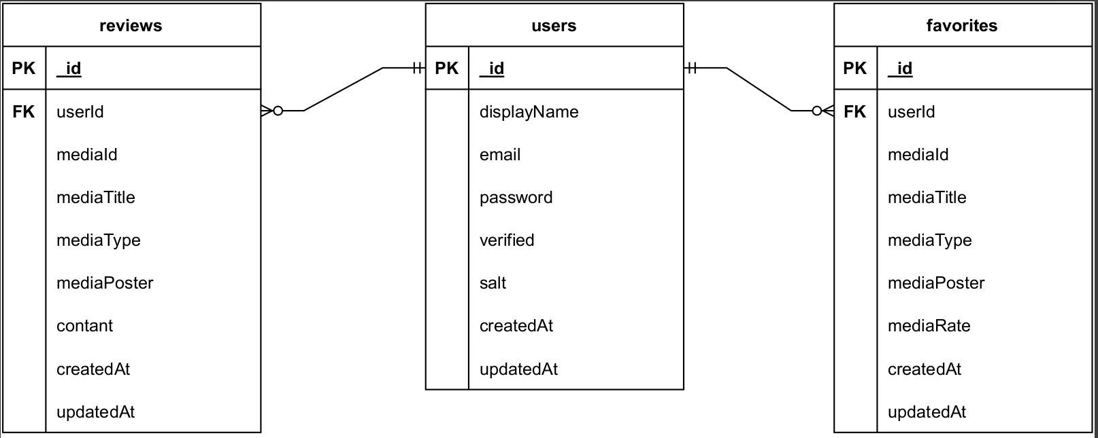
ER Diagram
ER Diagram

Slide 8
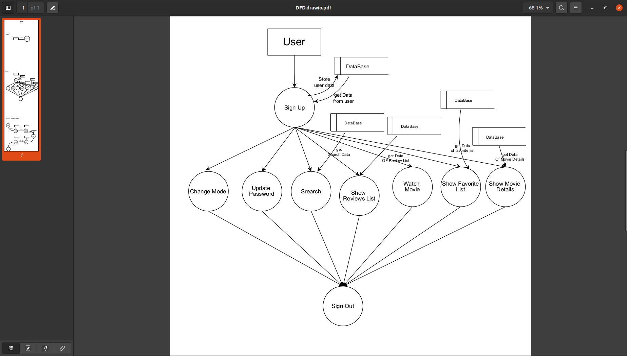
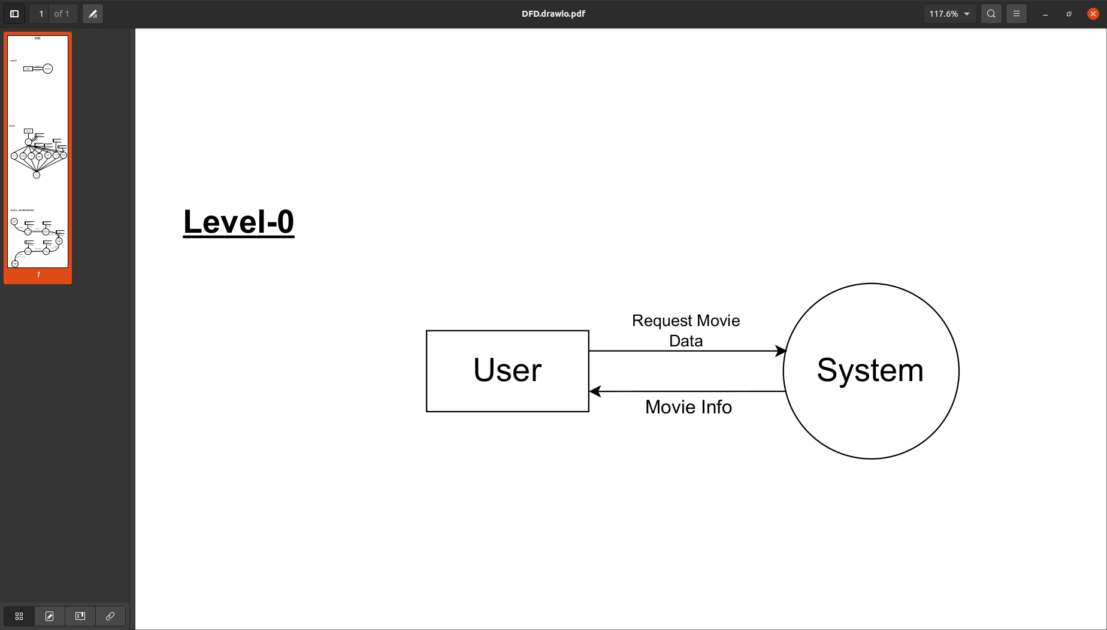
Data Flow Diagram
Level - 0
Level - 1

Slide 9
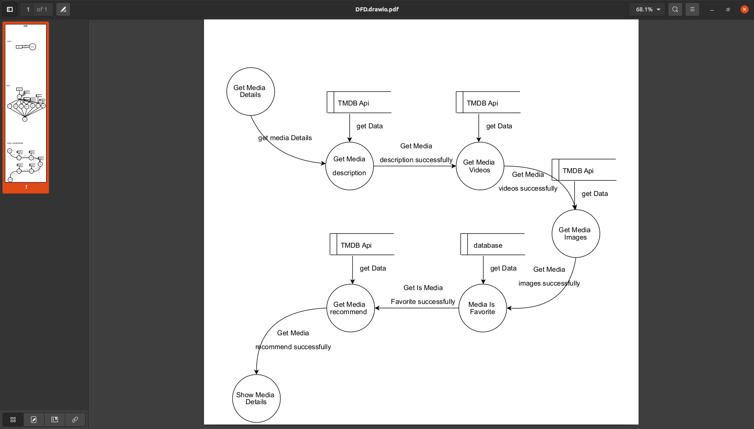
Data Flow Diagram
Level - 2

Slide 10
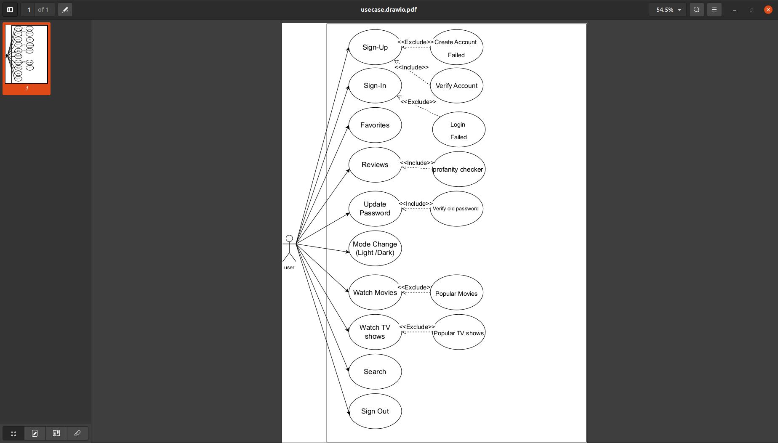
Use case Diagram
Use case Diagram

Slide 11
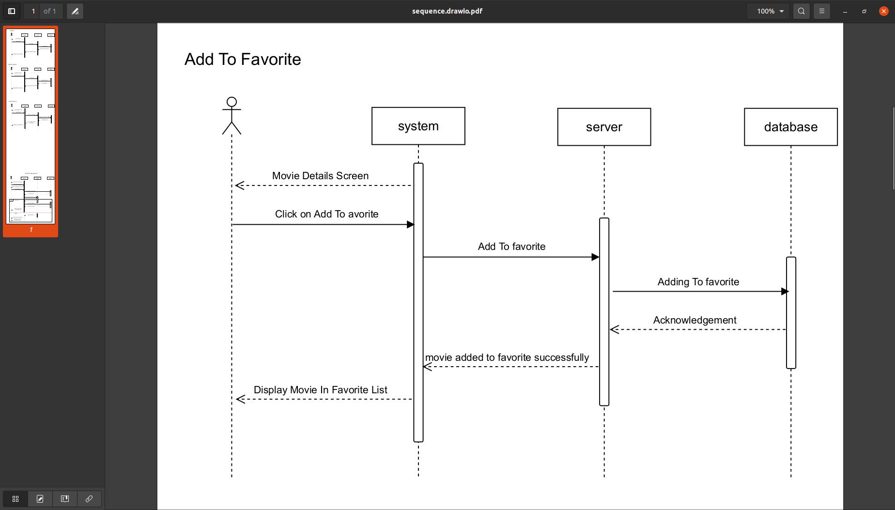
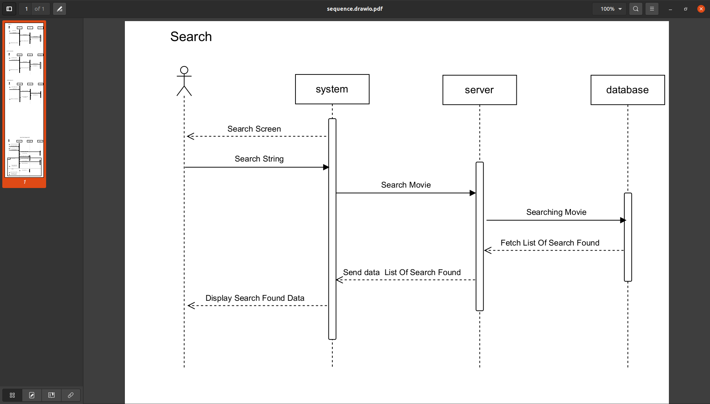
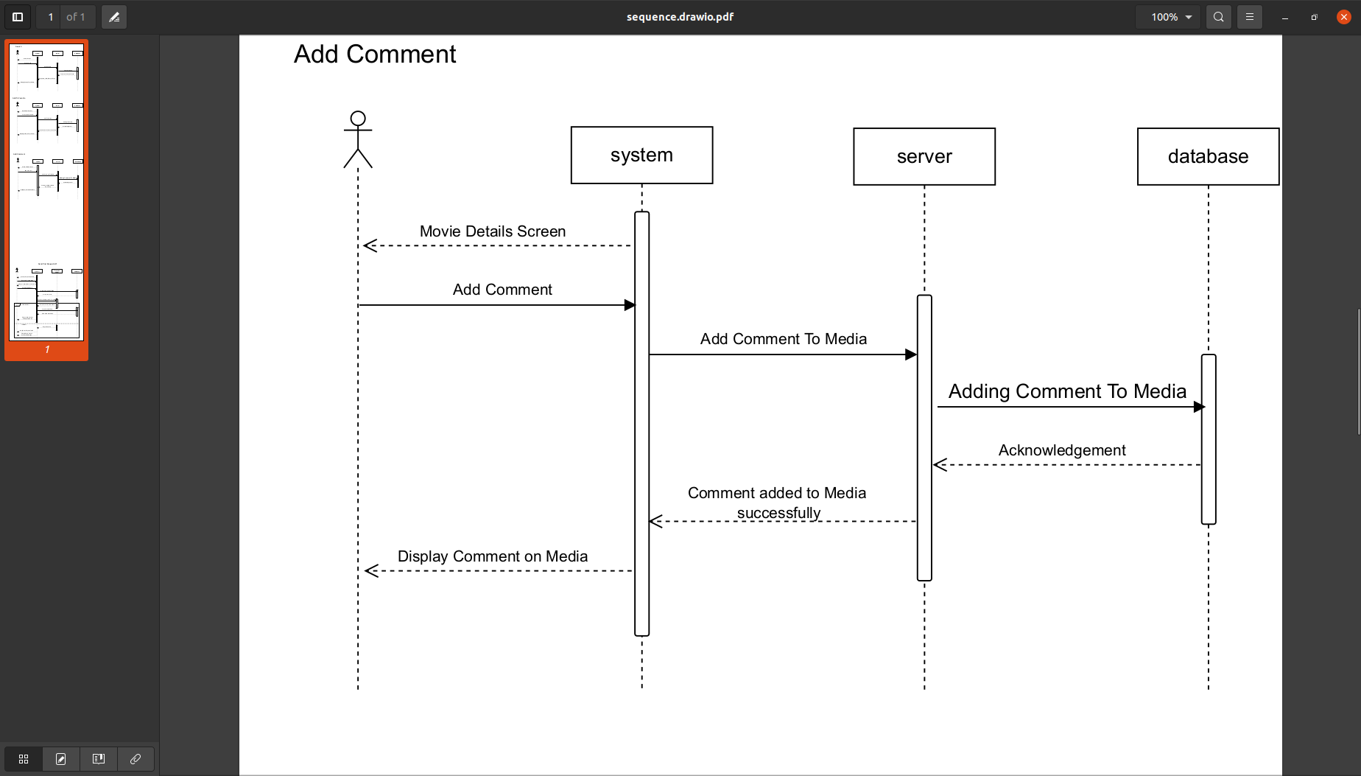
Sequence Diagrams
Sequence Diagram - Favorite
Sequence Diagram - Search
Sequence Diagram - Review

Slide 12
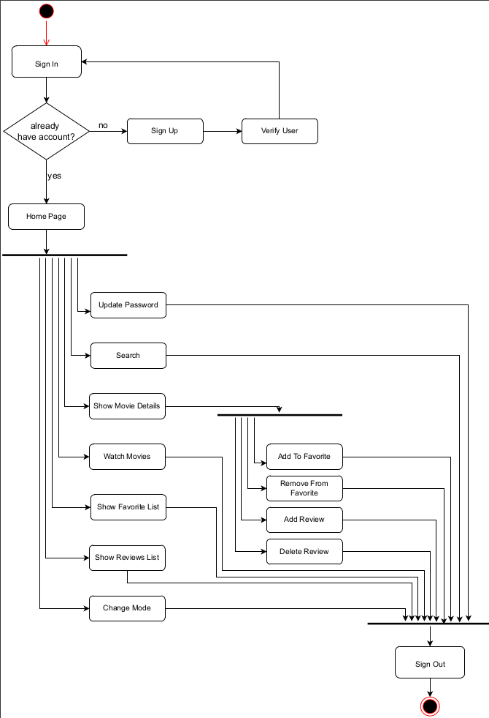
Activity Diagram
Activity Diagram

Slide 13
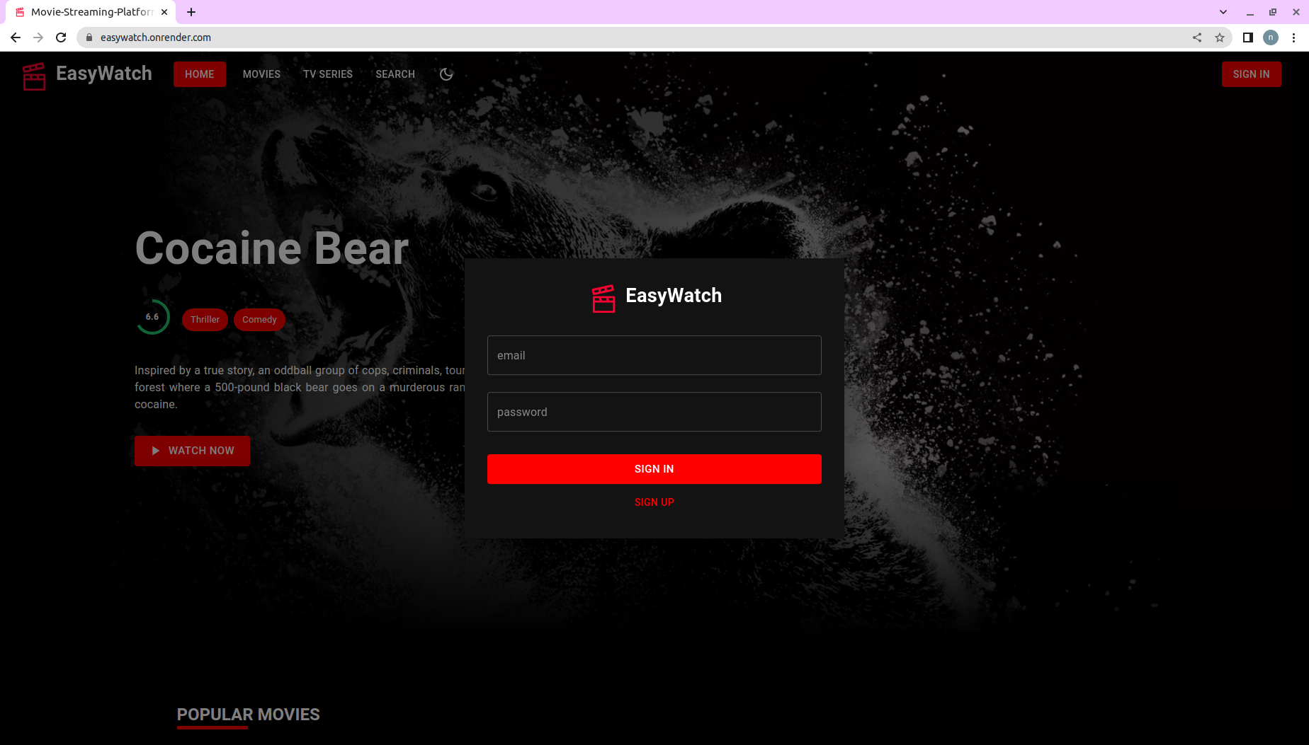
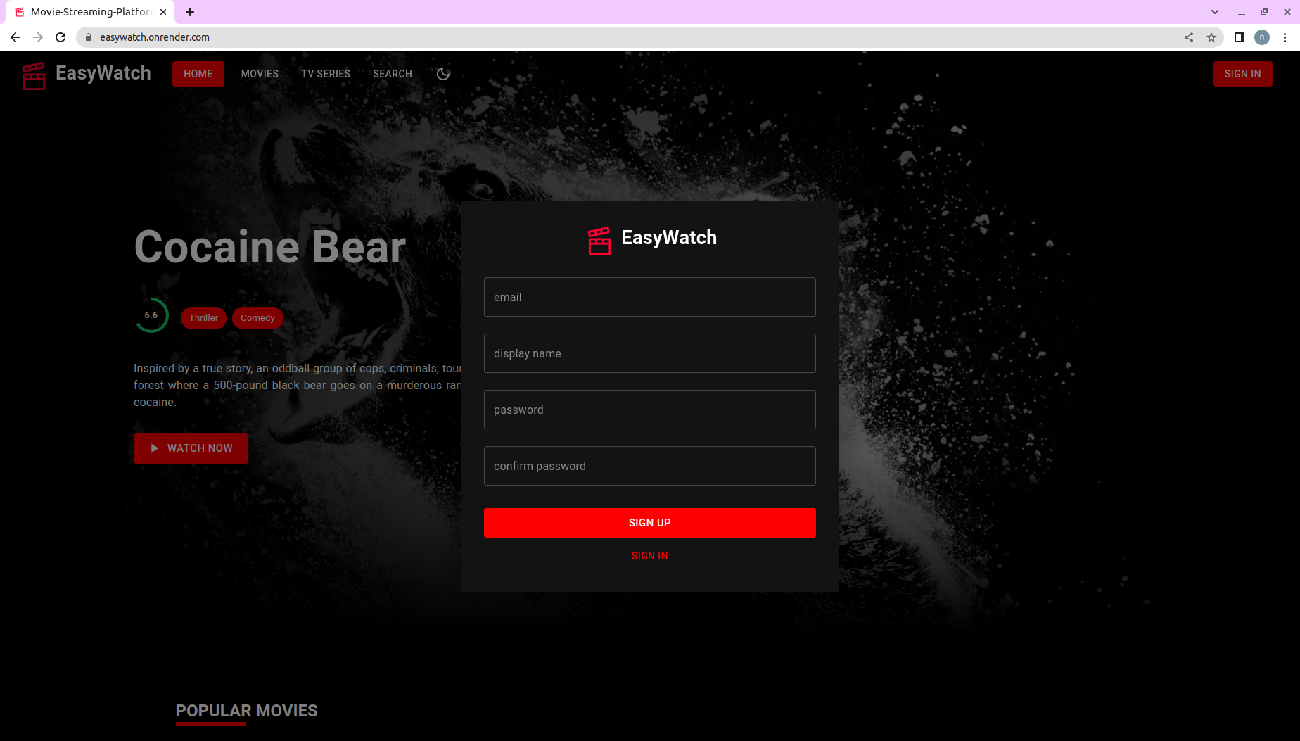
User Manual
Sign Up
Sign In

Slide 14
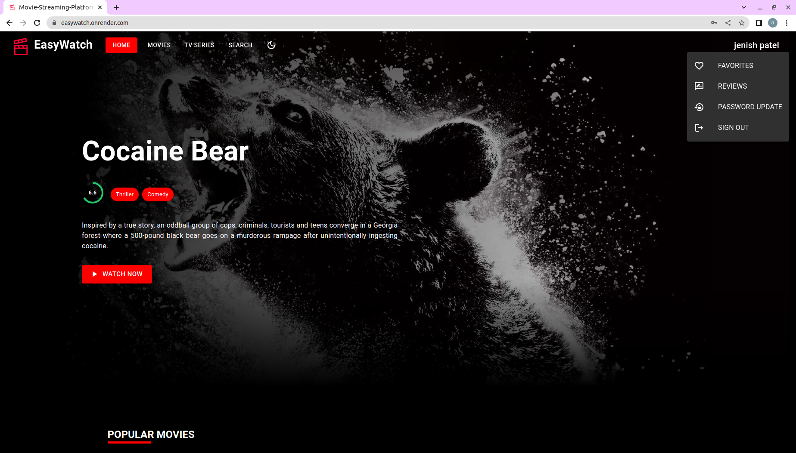
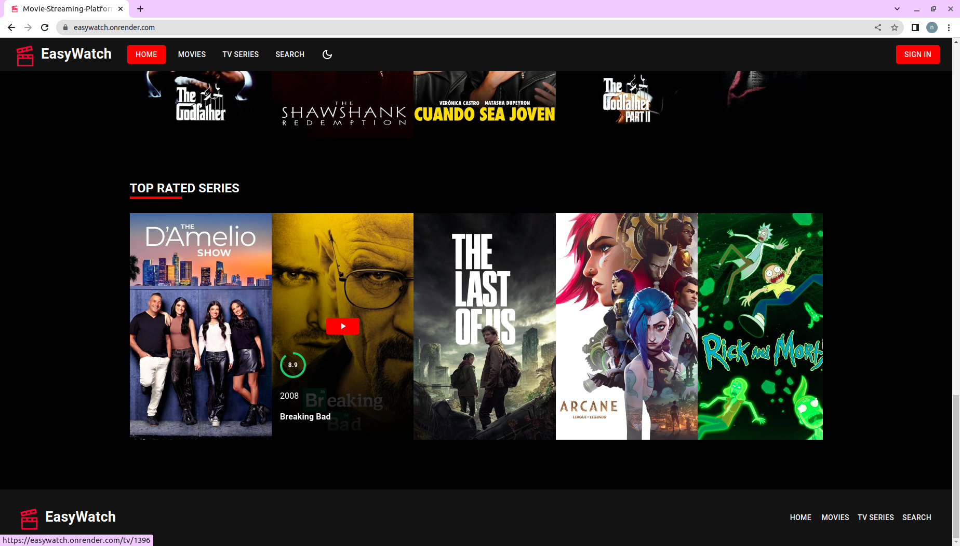
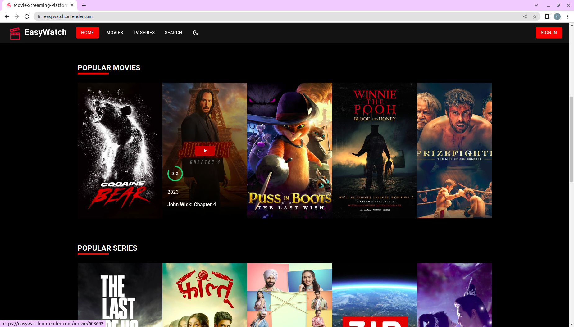
User Manual
Homepage

Slide 15
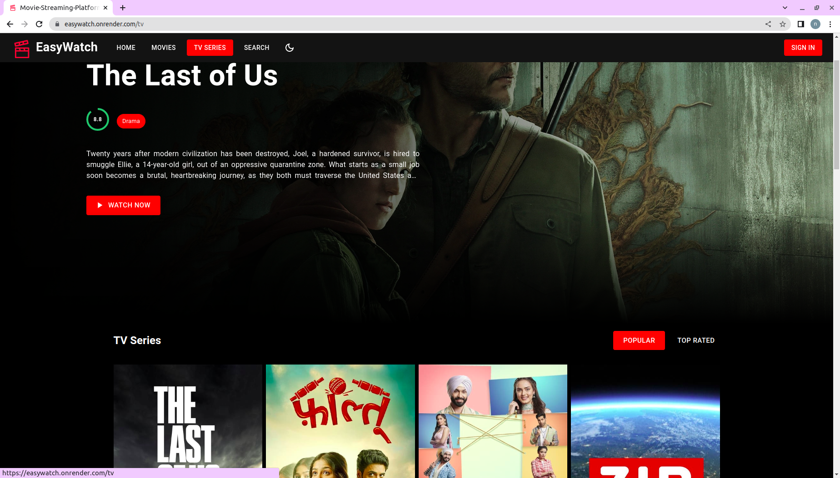
User Manual
TV Shows

Slide 16
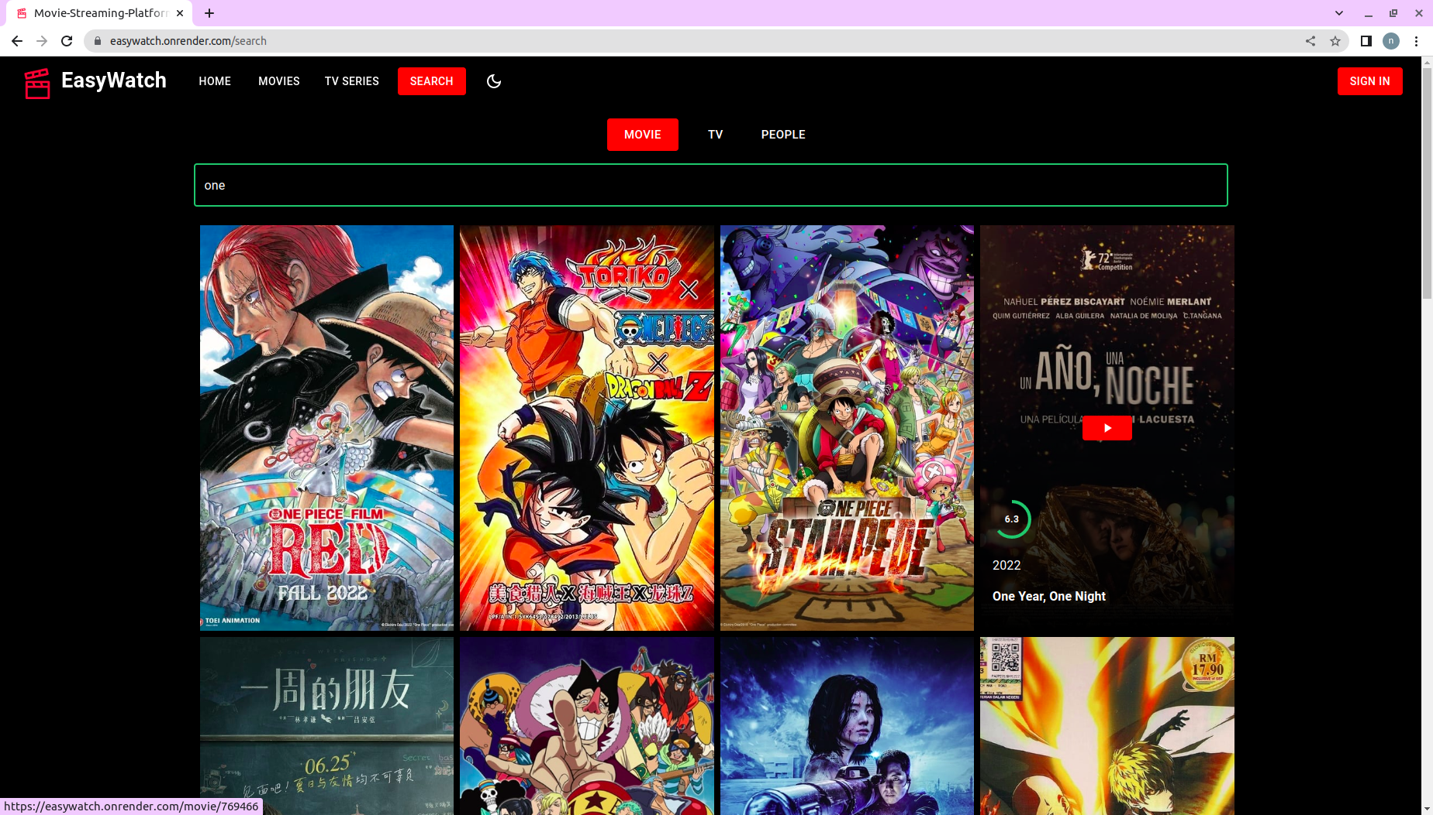
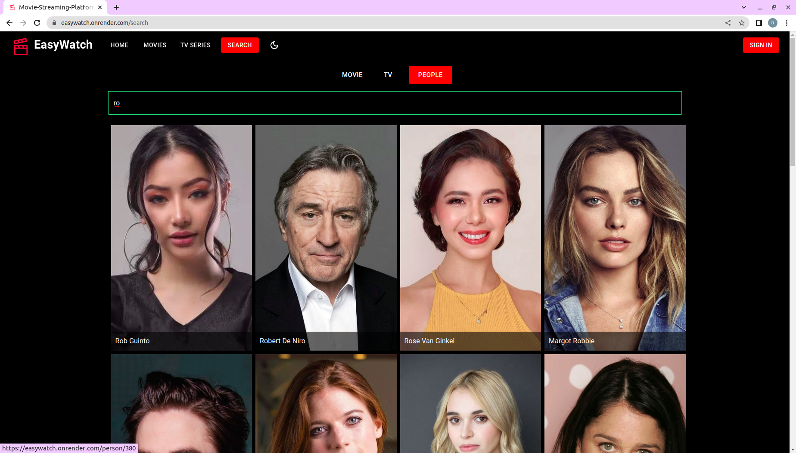
User Manual
Search Actor
Search Movies & TV Shows

Slide 17
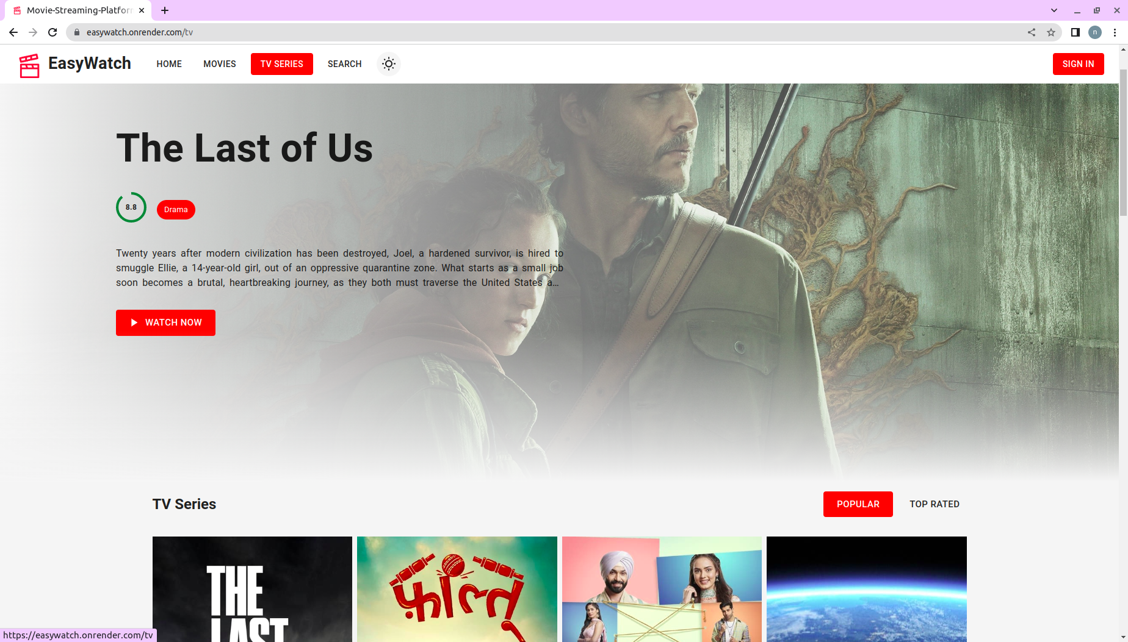
User Manual
Light Mode
Dark Mode

Slide 18
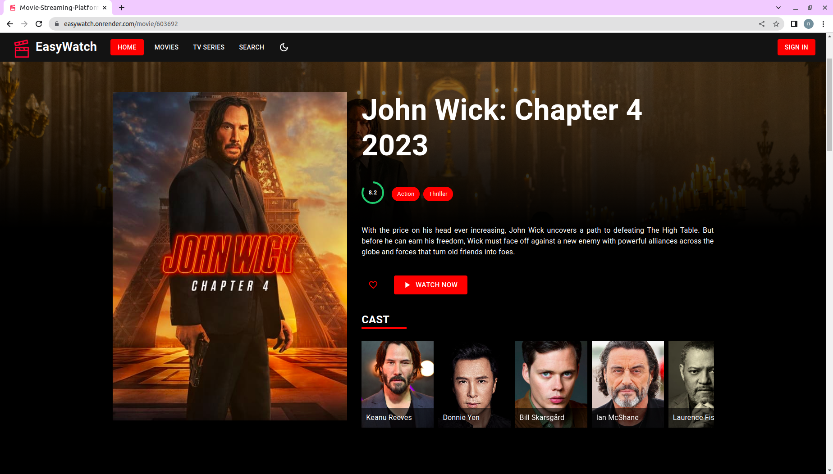
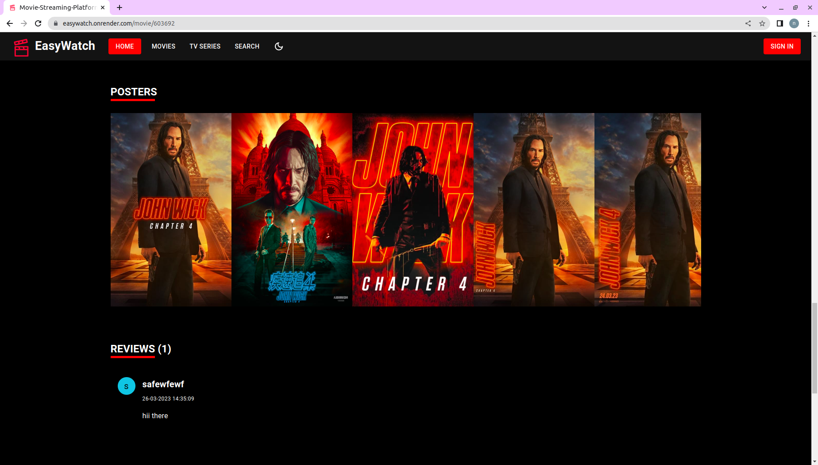
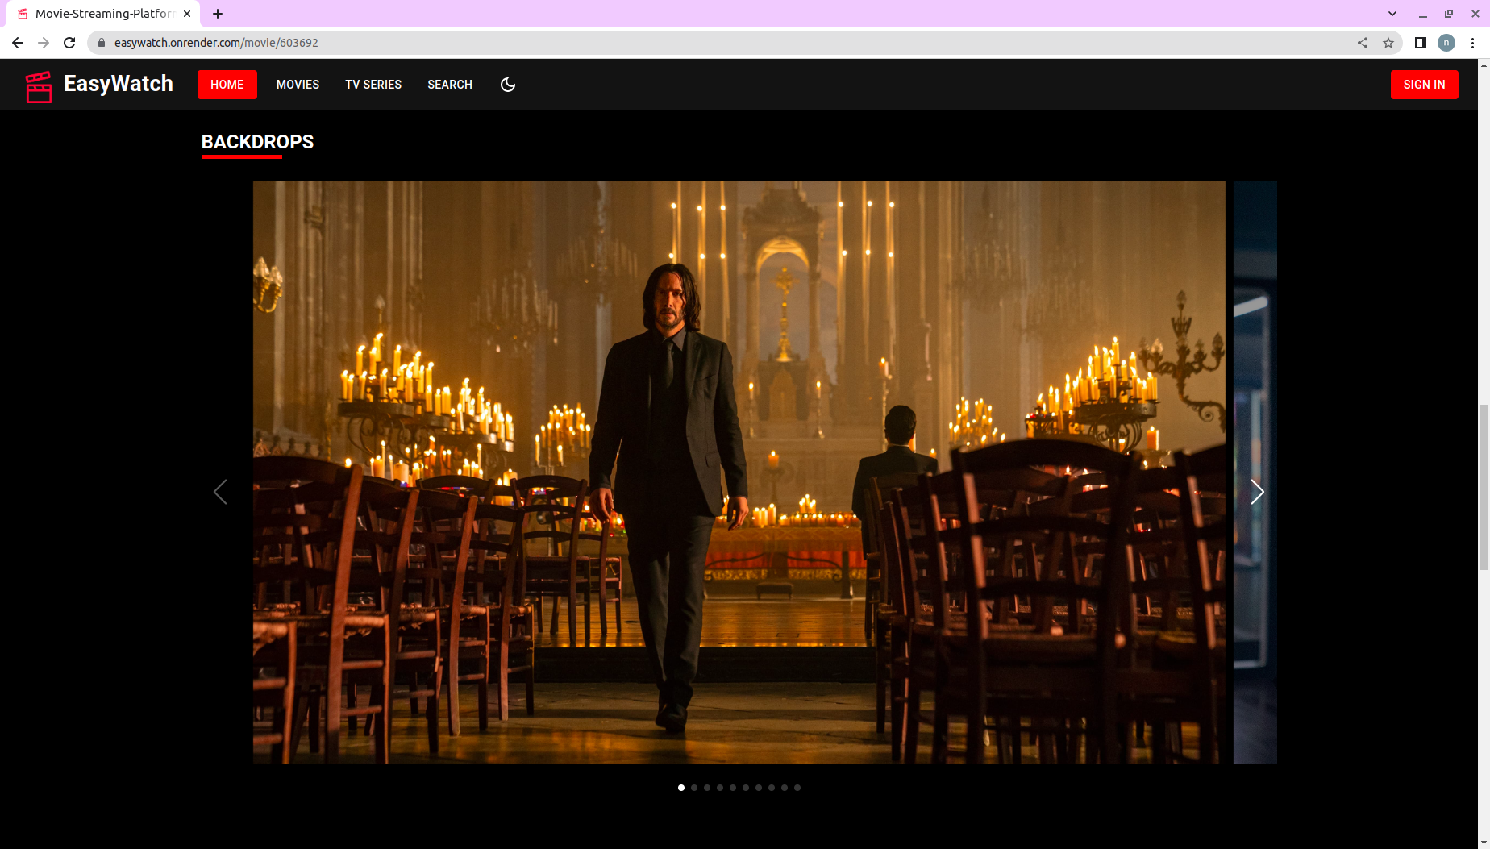
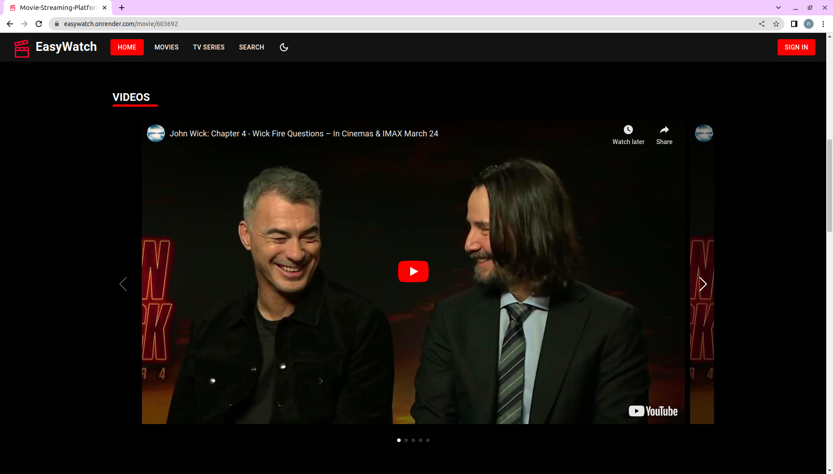
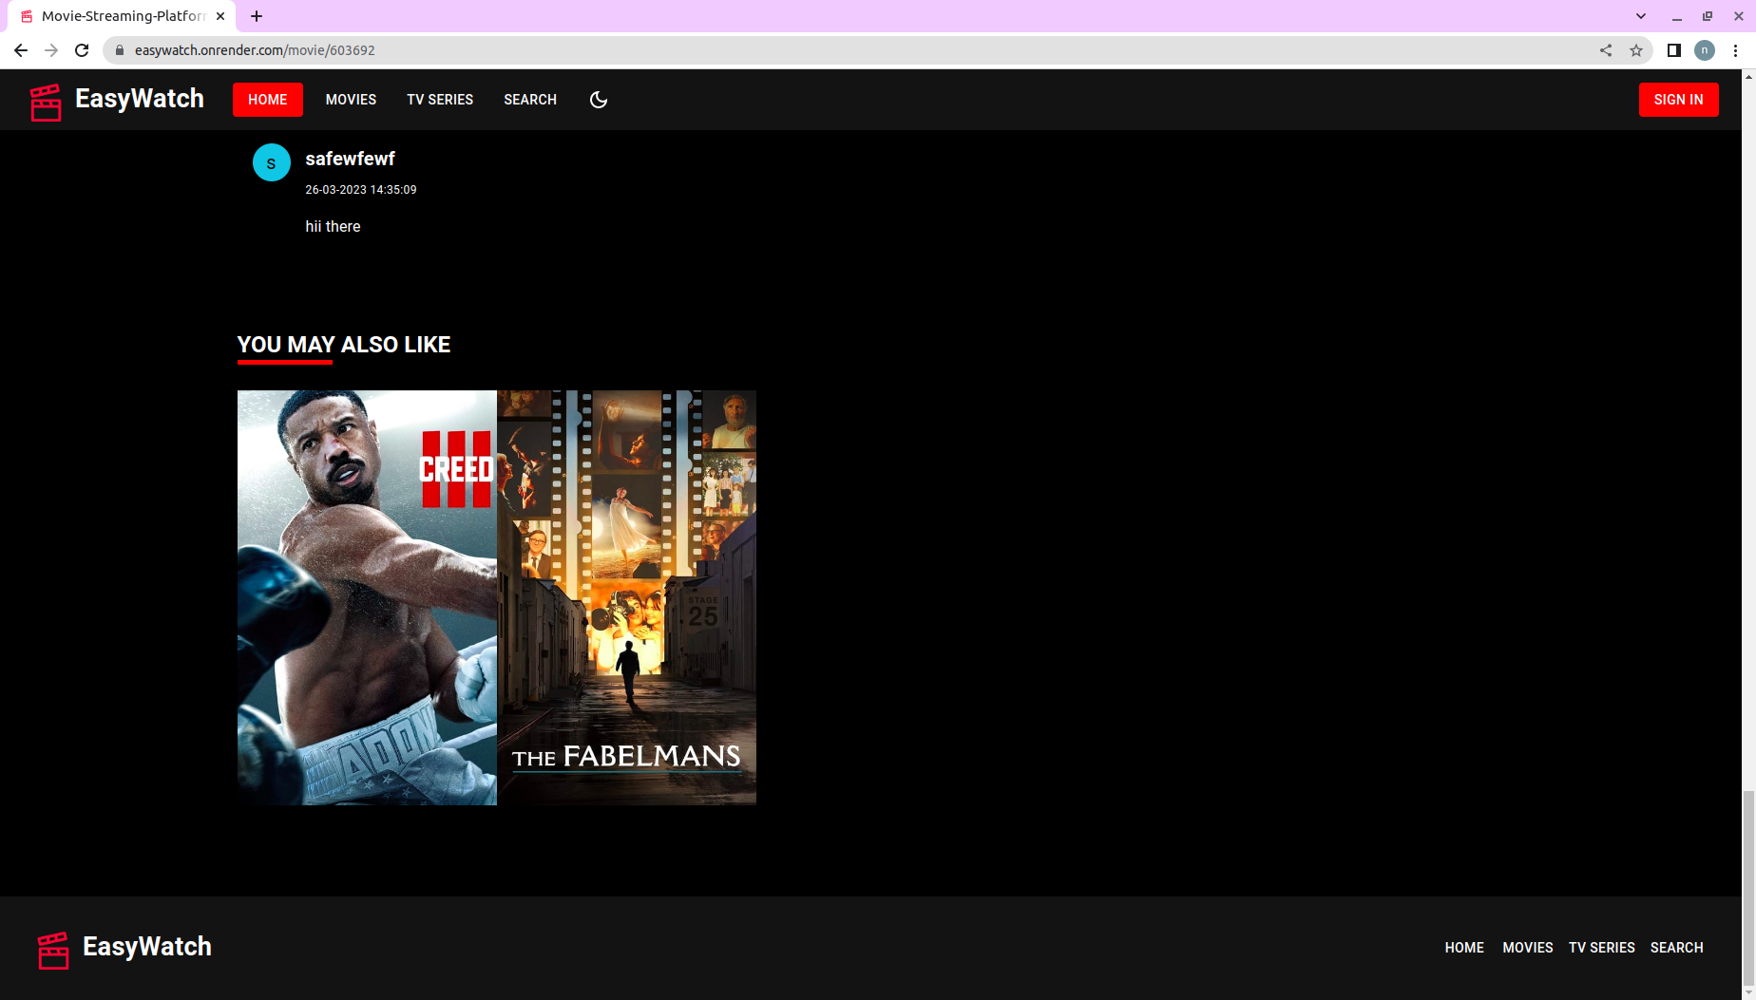
User Manual
Movie Details

Slide 19
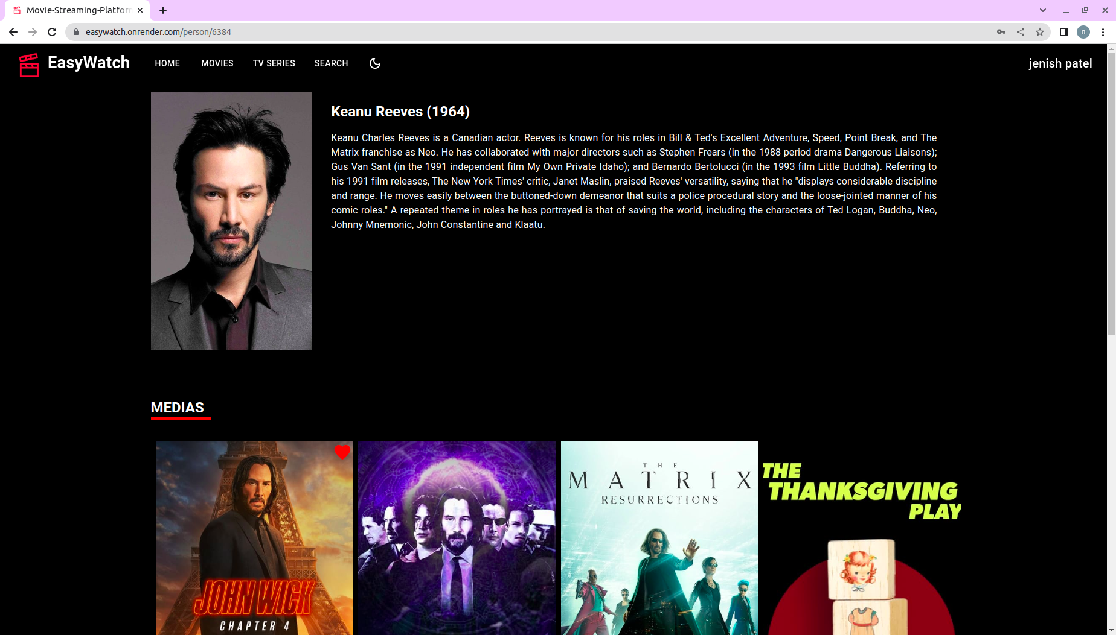
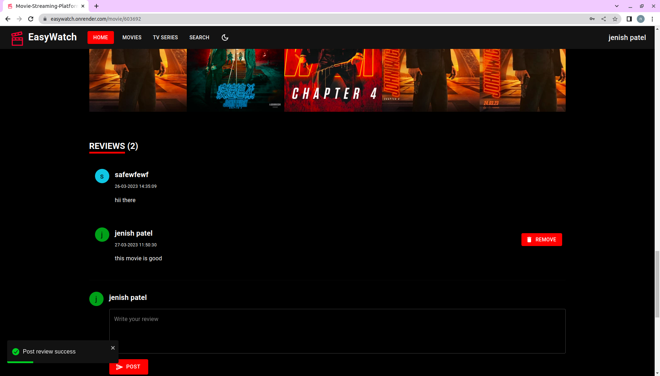
User Manual
Add Review
Actor Details

Slide 20
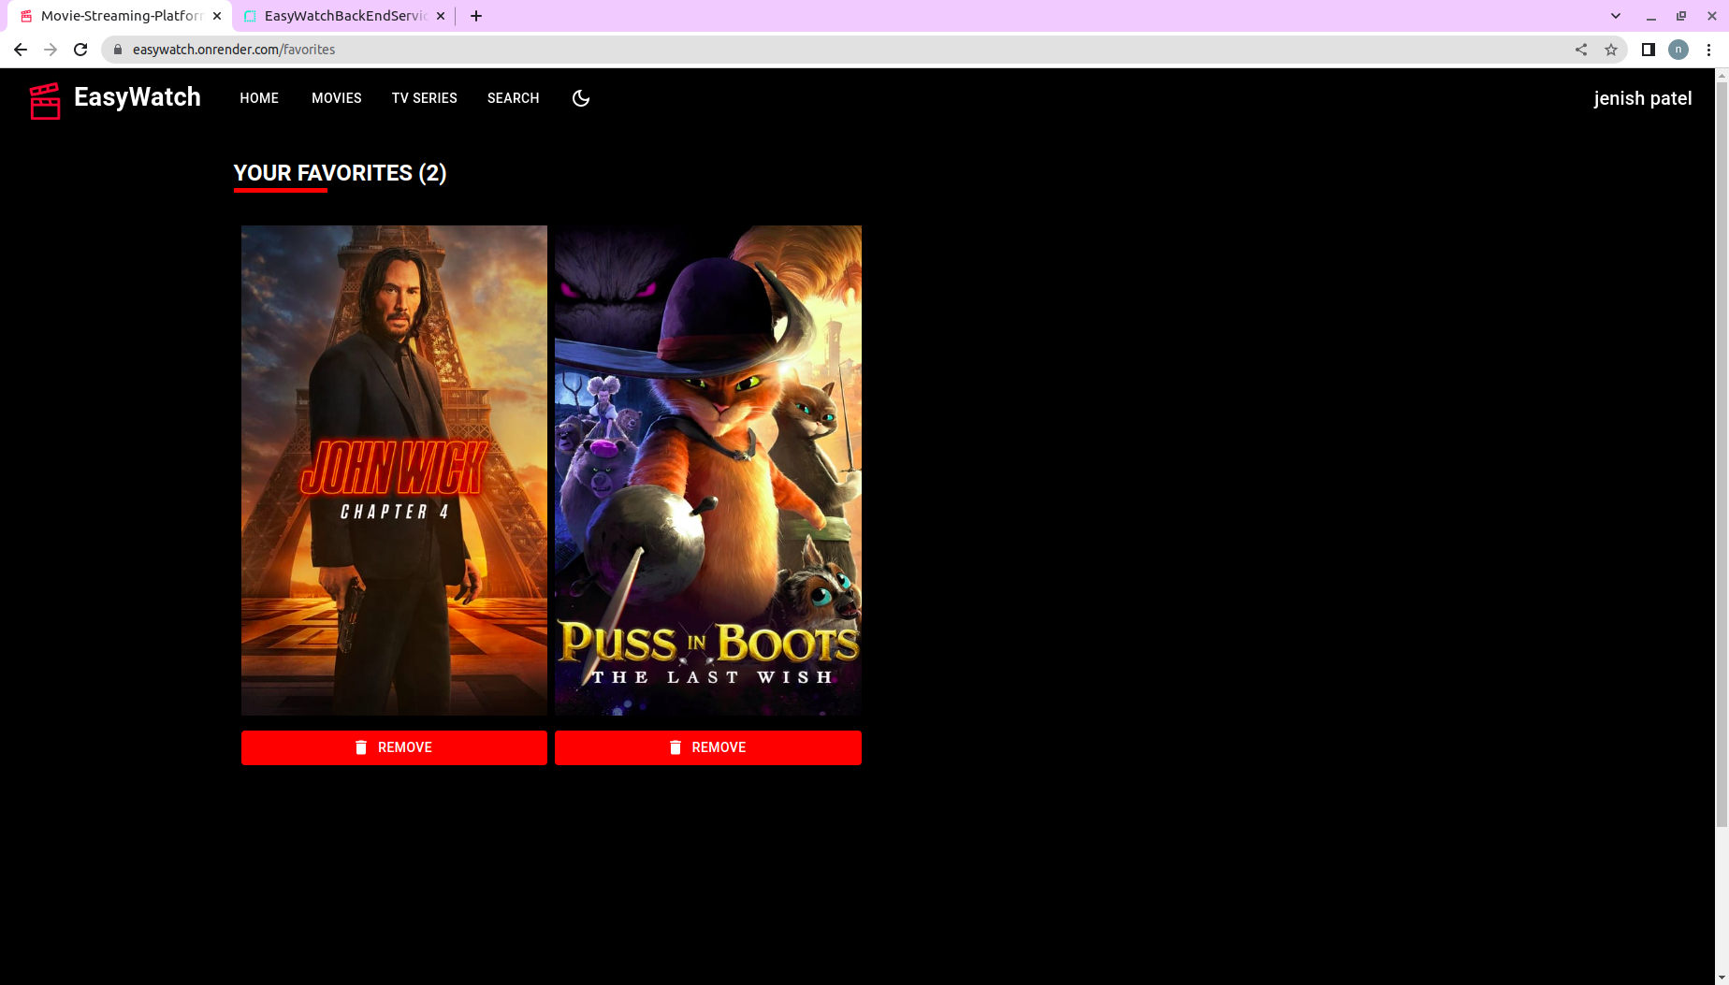
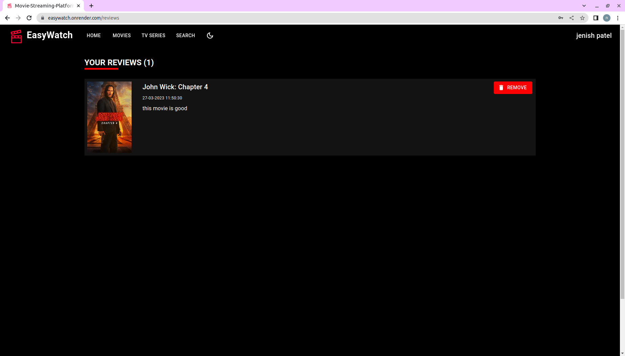
User Manual
Review List
Favorite List

Slide 21
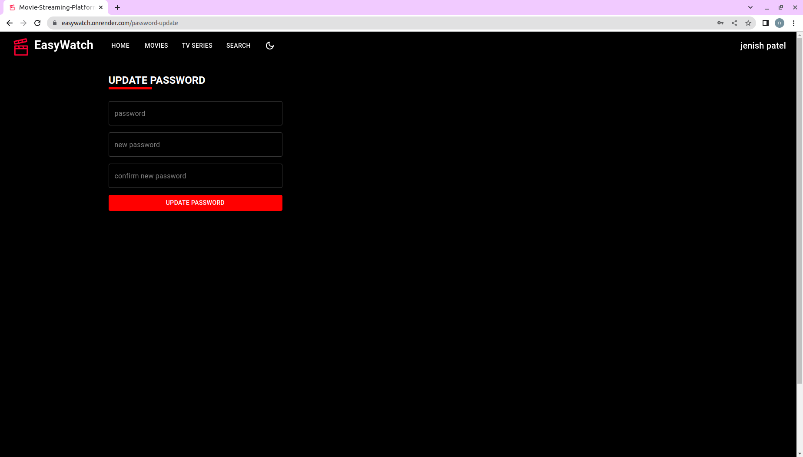
User Manual
Update Password

Slide 22
User Manual
Update Password

Slide 23
FUTURE ENHANCEMENTS :-
Store data of movies to our database. So , we can easily fetch it.
By optimizing code, Results will be generated much faster than this.
make a recommendation model for recommending movies to users according to their age.
Deploy Link :-
Front-end
https://easywatch.onrender.com
Bach-end
https://easywatchbackendservice.onrender.com

Slide 24
REFERENCES:-
React JS
https://reactjs.org/tutorial/tutorial.html
Node Js
https://nodejs.dev/en/learn/
https://www.npmjs.com/
https://www.w3schools.com/nodejs/
MongoDB
https://www.mongodb.com/docs/
https://www.w3schools.com/mongodb/
Other https://stackoverflow.com/
react-router-dom - npm (npmjs.com)

Slide 25
Thank U :)

